Slide 1
Eco Bike Rental
Group 8
Trần Thị Hằng- 20176748
Dương Thị Huê- 20176772
Đỗ Minh Thông- 20176881
Phạm Nhật Linh- 20184285

Slide 2
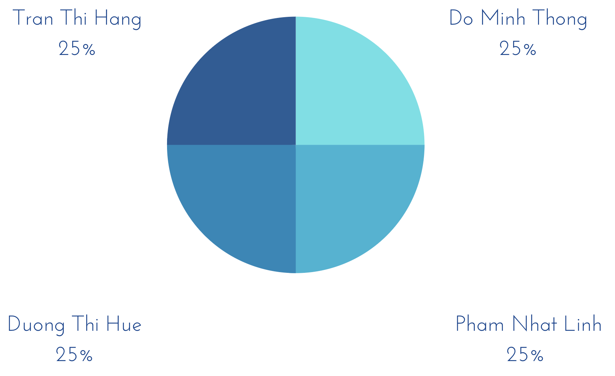
I. Member Contribution

Slide 3
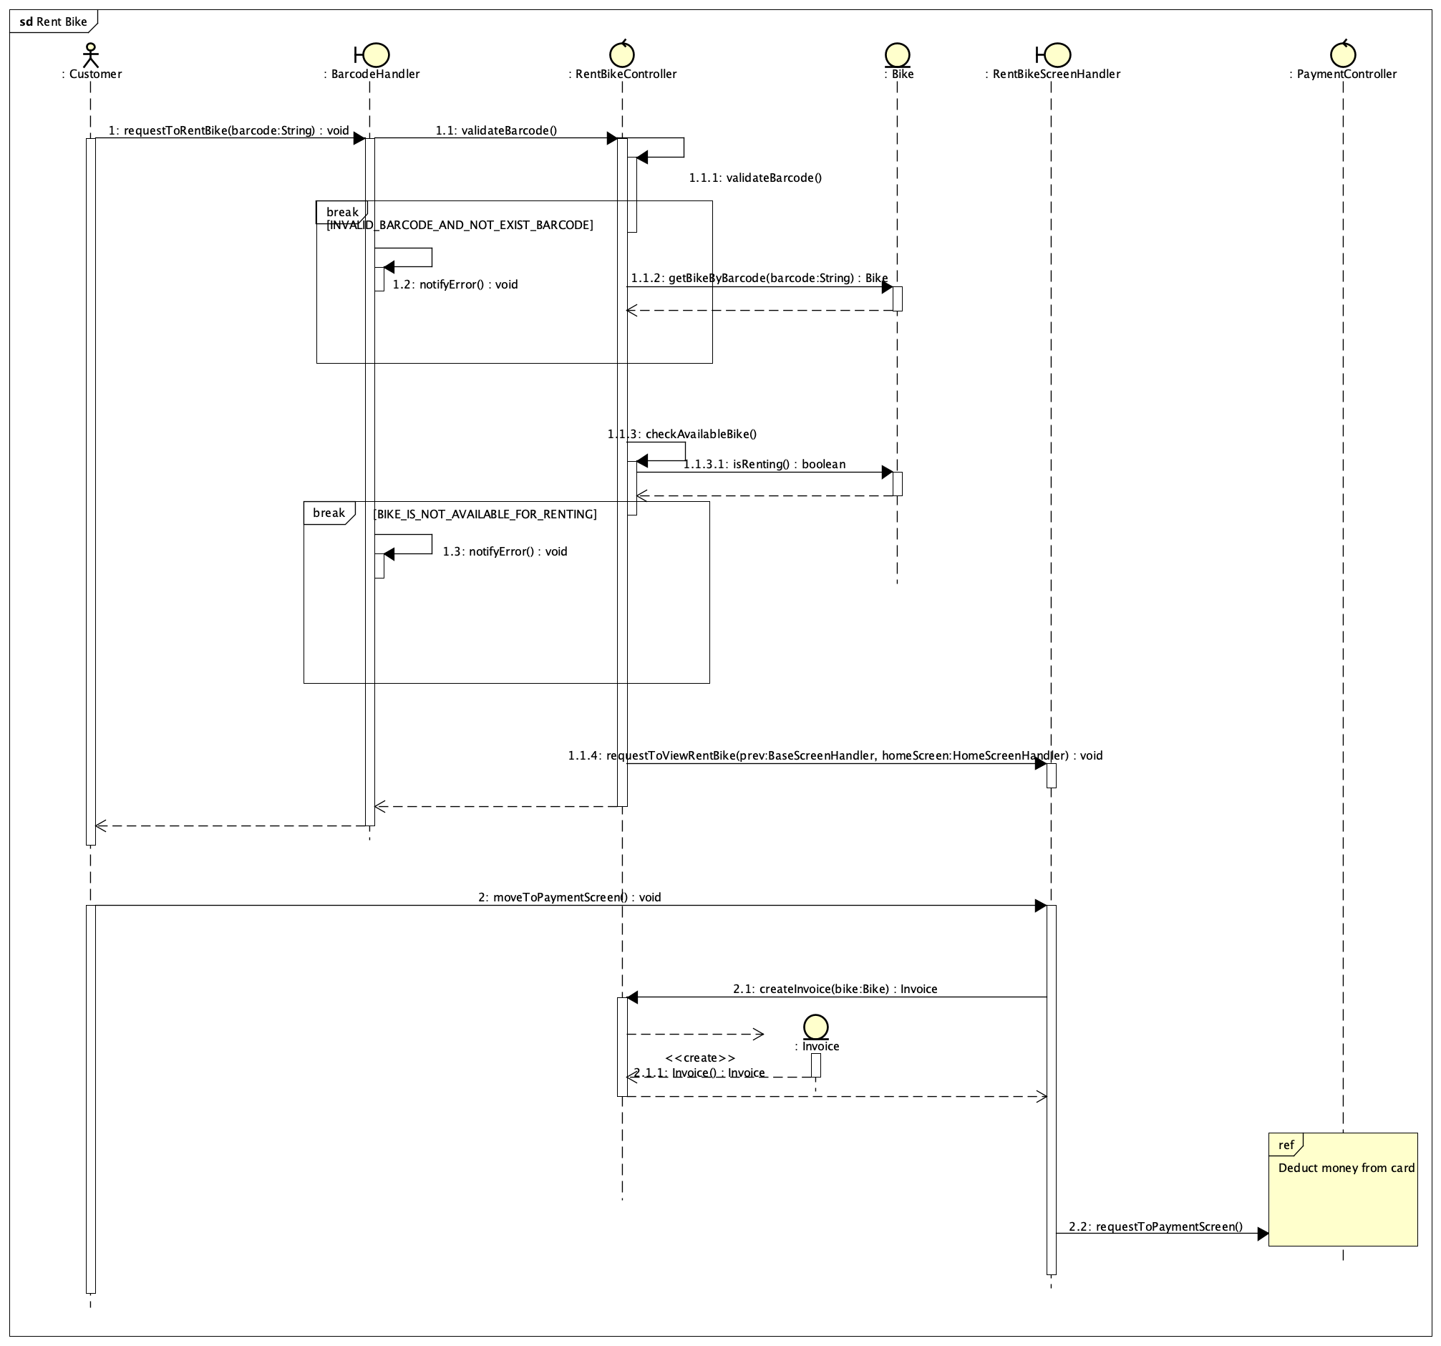
II. Typical Interaction Diagram
1. Sequence Diagram

Slide 4
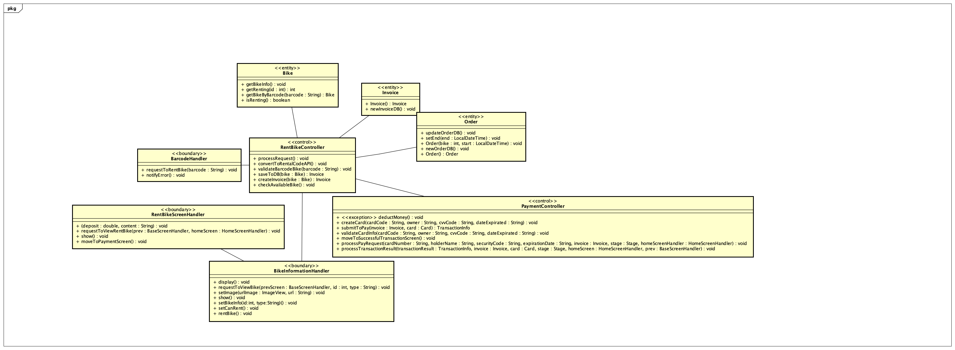
II. Typical Interaction Diagram
1. Sequence Diagram
2. Analysis Diagram

Slide 5
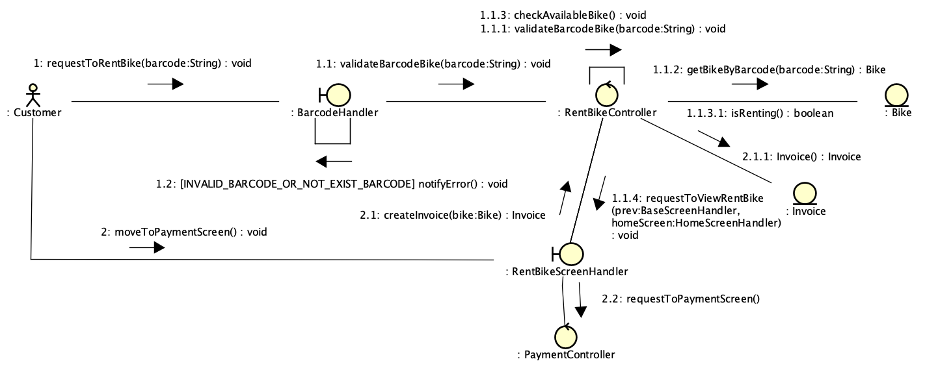
II. Typical Interaction Diagram
1. Sequence Diagram
2. Analysis Diagram
3. Communication Diagram

Slide 6
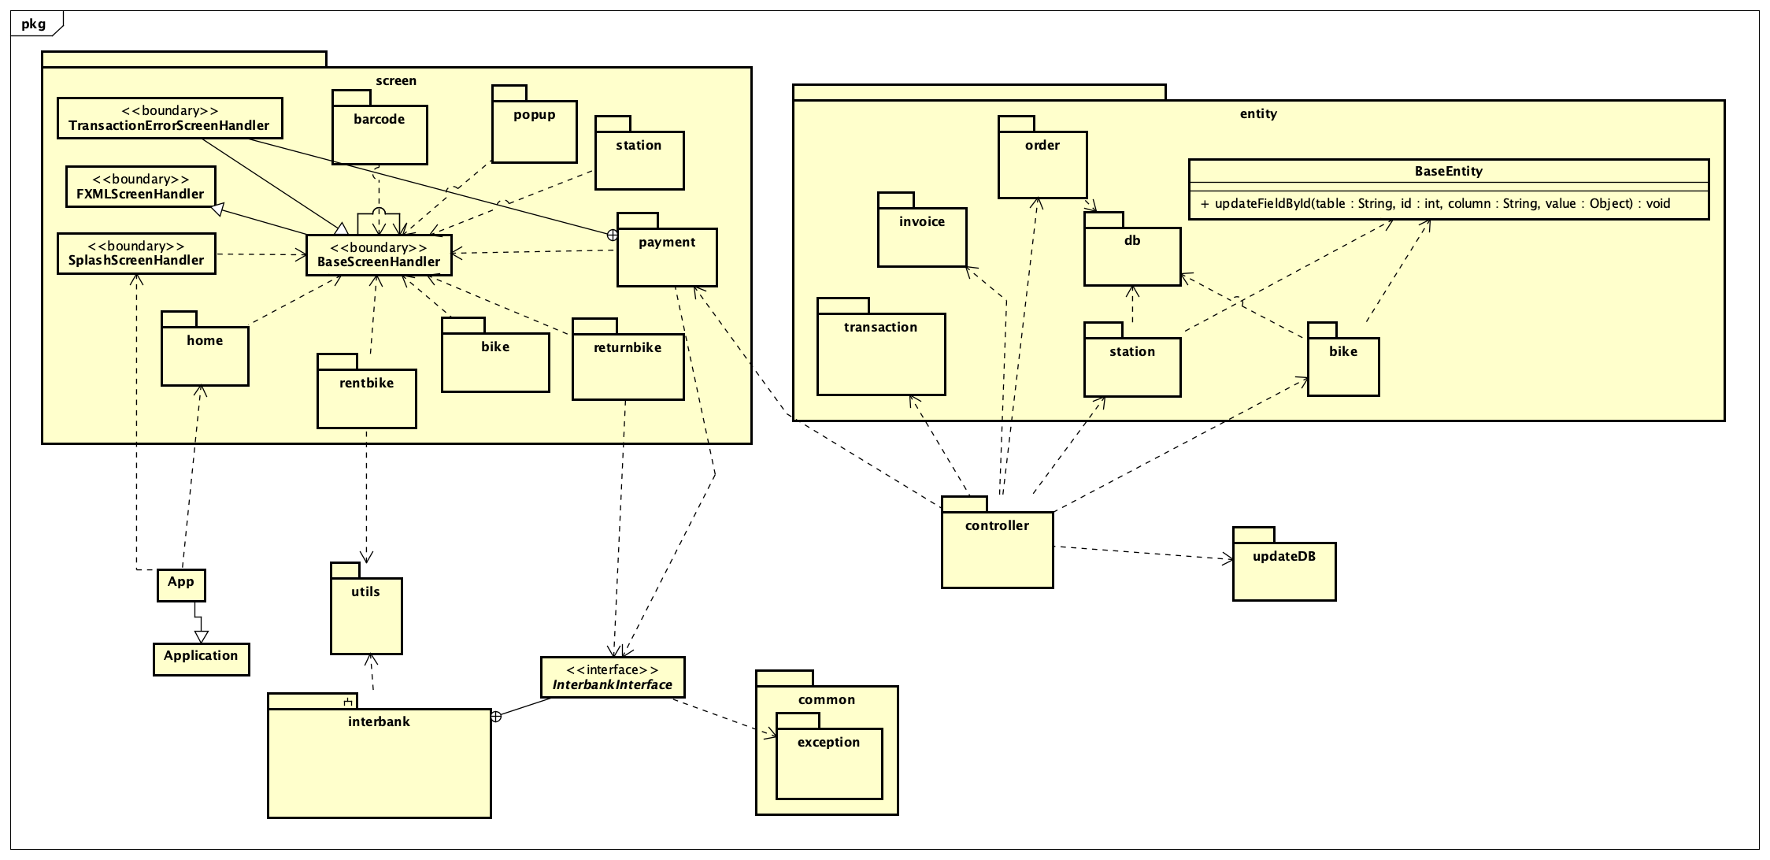
III. Class Diagrams
1. General Diagram

Slide 7
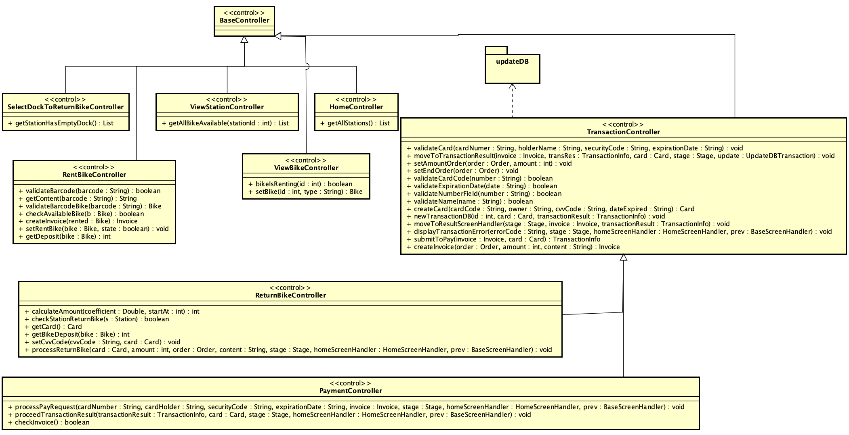
III. Class Diagrams
1. General Diagram
2. Detailed Diagram
a. Controller Class Diagram

Slide 8
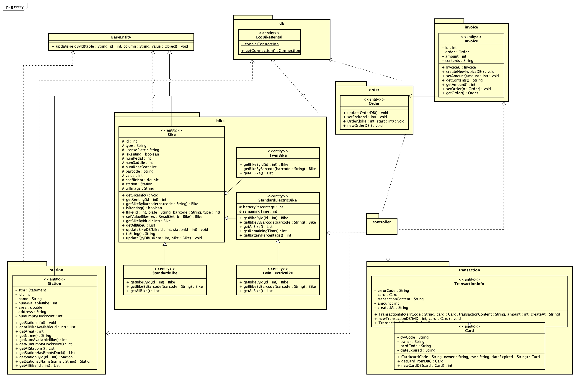
III. Class Diagrams
1. General Diagram
2. Detailed Diagram
a. Controller Class Diagram
b. Entity Class Diagram

Slide 9
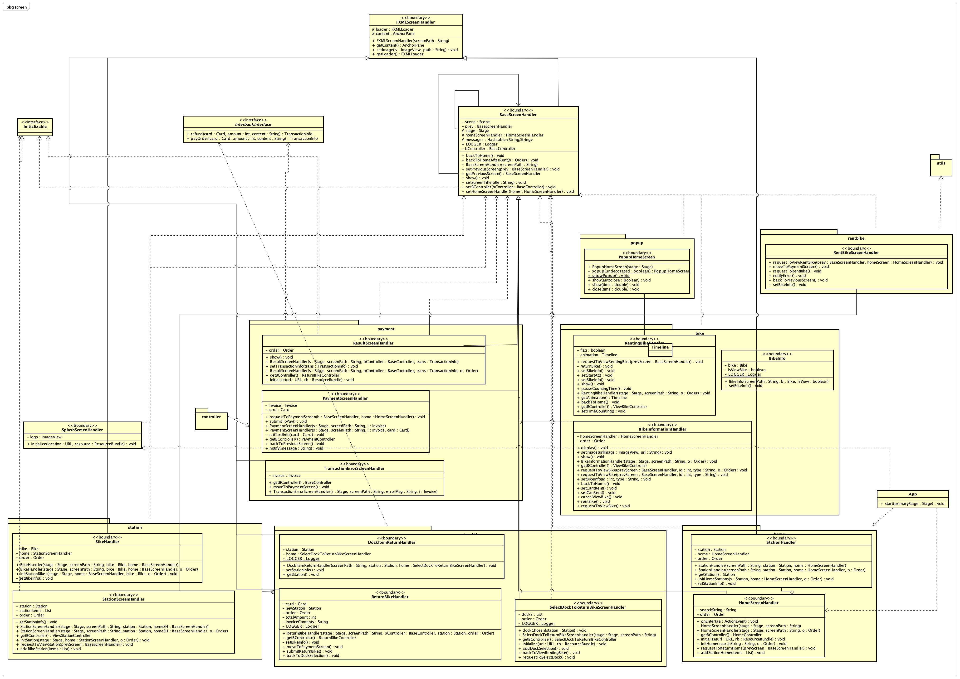
III. Class Diagrams
1. General Diagram
2. Detailed Diagram
a. Controller Class Diagram
b. Entity Class Diagram
c. Screen Class Diagram

Slide 10
IV. Design Considerations
Problems:
Control Coupling
Communicational Cohesion
1. Design Concepts

Slide 11
IV. Design Considerations
Design simple classes follow SOLID principles
1 class – 1 job – 1 responsibility
Open for extension but close for modification
Use interfaces, abstract classes. Subclasses can substitute for their base classes
Use specific interfaces
All classes with same properties into one package to manage easily
=> Reuse source code, adapt any changing requirements.
1. Design Concepts
2. Design Principles

Slide 12
IV. Design Considerations
Strategy pattern:
UpdateDBTransaction interface, class RentBike and ReturnBike implement it.
Two methods updateDB and moveToResultScreenHandler can be changed at run time .
=> Clean code, easier to switch between different algorithms
Facade pattern:
use InterbankInterface
=> Decreases complexity and provides an easier interface for communication.
1. Design Concepts
2. Design Principles
3. Design Patterns

Slide 13


Slide 14
Thank you for listening!

